Slide 1




Wavecon Telecom
Project
Presented by
-Saravanan
saravana291000@gmail.com

Slide 2



Agenda
1
About Telecommunication
Topics Covered
2
Data Exploration
3
Business Requirements
4
Explaining Visualization

Slide 3


About Telecommunication
What is Telecommunication?
Telecommunication (telecom) services refer to the transmission of information over distances for communication. These services include phone calls, internet access, and broadcasting, using various technologies such as fiber optics, satellites, and mobile networks.
Evolution of Mobile Networks
The mobile network has evolved through several generations, each bringing significant improvements in speed, capacity, and functionality:
1G: Analog voice calls.
2G: Digital voice calls, text messaging (SMS).
3G: Mobile internet access, video calling.
4G: High-speed internet, enhanced multimedia, and better connectivity.
Transition from 4G to 5G
Speed and capacity
Latency
Network Capacity
Reliability & Efficiency

Slide 4













Data Exploration
Dataset Details:
Dim Cities - This table contains the list of city code and name
Dim dates - This table contains the whole date includes before 5G and after 5G.
Dim plan - This gives the plan description.
Market Share - Details about the market share
Plan revenue - Details of plan’s revenue
Wavecon metrics - Has active users and count of unsubscribed users.
Data modelling:
Data modeling is a crucial step in the design of a database system. It involves creating a visual representation of the data structures and relationships that will be stored in a database. This process ensures that data is organized in a way that facilitates efficient retrieval, manipulation, and storage.

Slide 5










Business Requirements
What is the impact of the 5G launch on our revenue?
Which KPI is underperforming after the 5G launch?
After the 5G launch, which plans are performing well in terms of revenue? Which plans are not performing well?
Is there any plan affected largely by the 5G launch? Should we continue or discontinue that plan?
Is there any plan that is discontinued after the 5G launch? What is the reason for it?

Slide 6

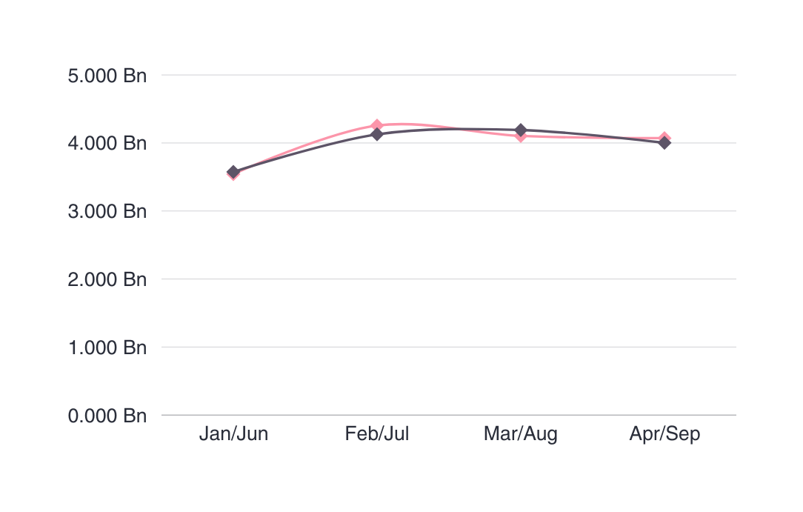
Impact of 5G on our revenue
Total Revenue After 5G:
15.89 BILLION
Revenue Difference:
-0.11 BILLION
Revenue Change %:
-0.50%

Slide 7

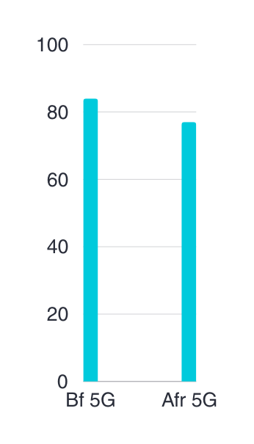
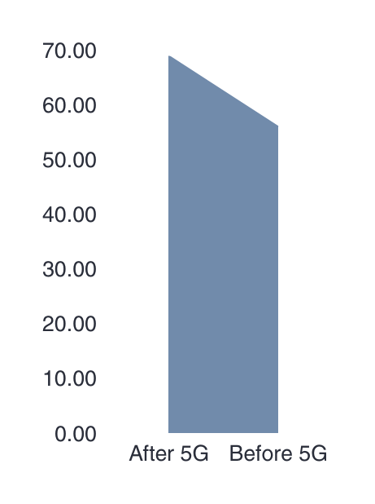
Which KPI is underperforming after the 5G launch?
TaU - Total active users
Tusu - Total unsubscribed uesrs
Total Active Users Diff:
7 M
Total Unsubscribed Users Diff:
13 M
TaU change %
Tusu change %
- 8.28%
- 19.06%

Slide 8
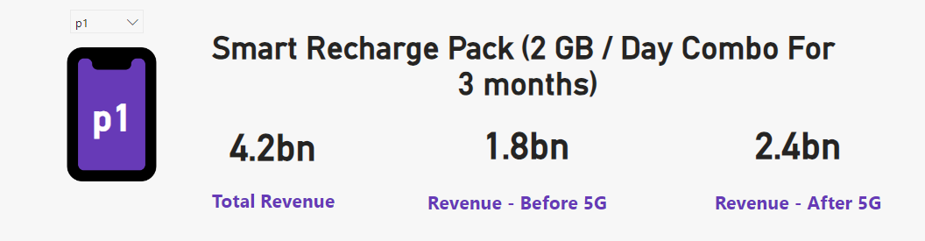
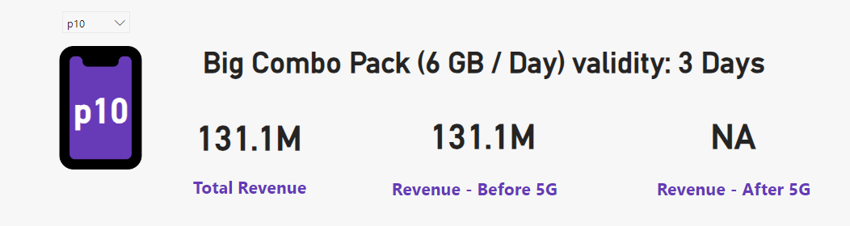
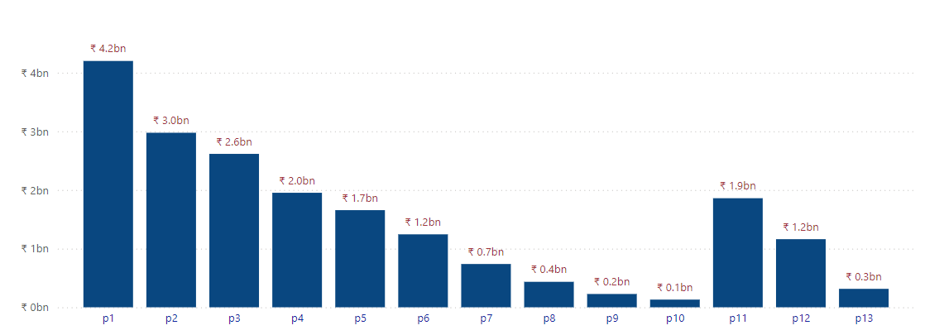
After the 5G launch, which plans are performing well in terms of revenue? Which plans are not performing well?
Well performing
Poor performing

Slide 9
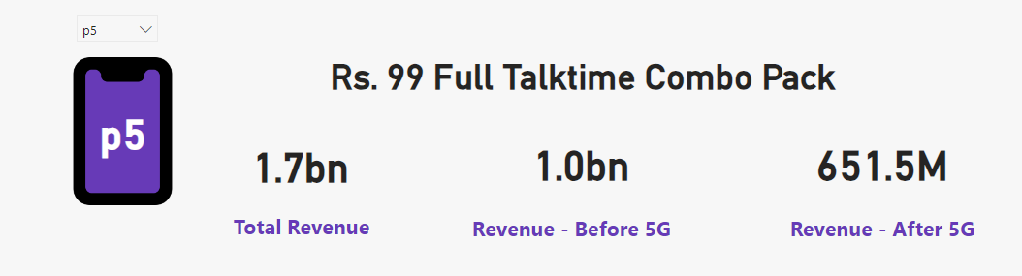
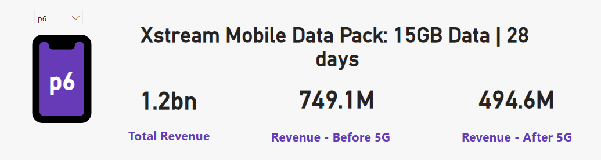
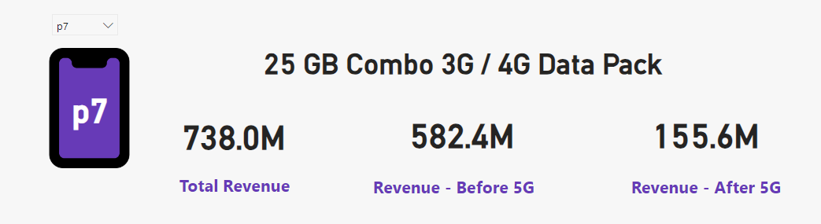
Is there any plan affected largely by the 5G launch? Should we continue or discontinue that plan?
Plan 5:
The pack is mainly for Talktime users, so the persons who mostly using net will not recharge this plan. And we dont need to discontinue this because its affect the talktime users.
Plan 6:
The reason for the revenue loss for this plan is the data pack for this plan is not suited for 5G network. We have to increase the data pack and dont need to discontinue this.
Plan 7:
This plan should be discontinue for 5G users. Because the plan itself for 3G/4G users only.

Slide 10
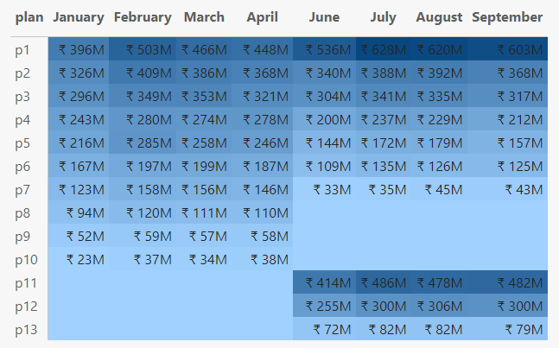
Is there any plan that is discontinued after the 5G launch? What is the reason for it?
P8, P9, P10 are cancelled after 5G.
P11, P12 ,P13 are newly added plans after 5G.

Slide 11
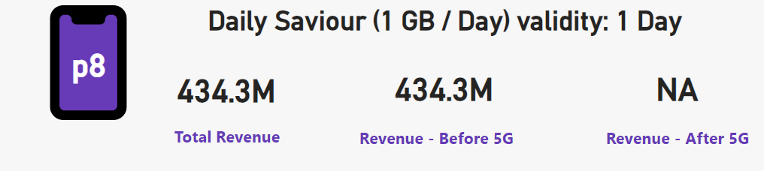
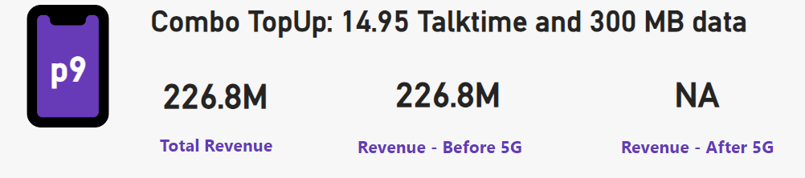
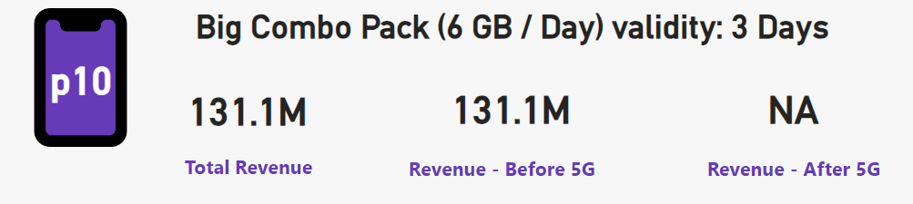
Cancelled plans
Plan 8:
The pack is cancelled because we know 1GB data pack will not sufficient for 5G users.
Plan 9:
The pack is cancelled because it is mainly for talktime users not for users who needs network
Plan 10:
I don’t know why they cancelled it, for me it seems like useful plan. Why I am saying this because per day 6 GB is good for internet using persons. May be the cost of the plan is the reason for cancellation.

Slide 12

Thank you!!

